Slide 1

Risk is not just perceived as variance
Janine Hoffart, Jana Jarecki, Jörg Rieskamp

Slide 2
Observation: Risk/Variance and Return tend to be Positively Related
SMI 20
Positive Relationship between variance and expected value
Notes:
Entwicklung der jährlichen Renditen (Durchschnittliche Jahresrendite) von 19 verschiedenen Schweizer Aktien von 2003 bis 2015.

Slide 3
Paradox: When asked to judge the risk of investment options
“How risky is it to invest in … ?”
Far below average O O O O O Far above average
e.g., Kempf, Merkle & Niessen-Ruenzi (2014)

Slide 4
Paradox: Humans perceive a Negative Relationship
Risk
(=Variance)
Risk
(=Variance)
≠
$ $$ $$$
Return
$ $$ $$$
Return
True relationship
between risk (variance) and return.
Perceived relationship
between risk (variance) and return.
e.g., Kempf, Merkle & Niessen-Ruenzi (2014)

Slide 5
Question: Do humans perceive risks as costs?

Slide 6
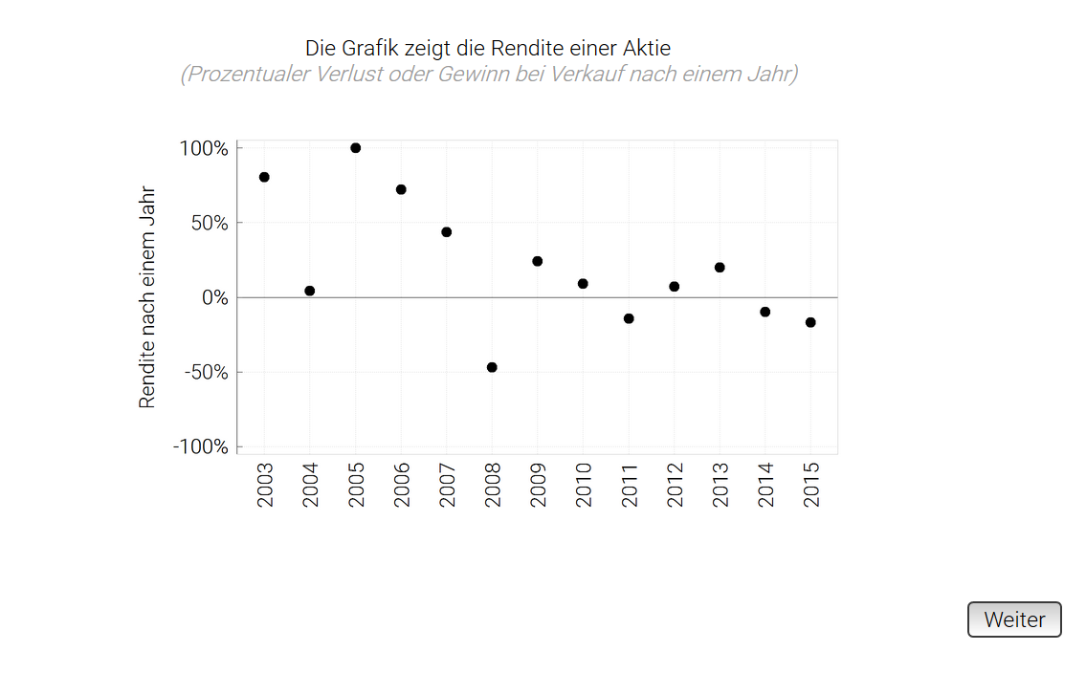
Task: Judge the riskiness of several real-world stock courses
Study design
“How risky is it to invest in this stock?”
19 real-world stock developments
True returns only shown graphically

Slide 7
Design: Within-subject manipulation of risk terminology
“How risky is it to invest in this stock?”
“How predictable is the return trajectory of this stock?”
“How variable is the return trajectory of this stock?”
“How much does the return fluctuate for the stock?”
“How high is the return?”
“How high is the expected loss?”

Slide 8
Question: Which risk terminology allows people to judge the true variance accurately?

Slide 9
“How risky is it to invest in this stock?”

Slide 10
“How predictable is the return trajectory of this stock?”

Slide 11
“How variable is the return trajectory of this stock?”

Slide 12
“How much does the return fluctuate for the stock?”

Slide 13
“How much does the return fluctuate for the stock?”
 | Scale
 | Risk | Predictability | Variability | Fluctuation
Variance_{Objective} | 12.92 | -17.43 | 25.89 | 28.56
AIC | 6293 | 6049 | 5450 | 5264

Slide 14
Open-ended Question: «What does it mean for you if a stock has a high risk?»
Uncertainty / Predictability
Gain
Variance / Fluctuation
Loss
Other

Slide 15
Paradoxes related to the perception of variance are driven by differing notions of «risk»

Slide 16
Replication of results with international stocks
OMX

Slide 17
Design: Within-subject manipulation of risk terminology
“How do you judge the risk associated with this stock?”
“How do you judge the risk (measured as variance) associated with this stock?”
“How do you judge the fluctuation associated with this stock?”

Slide 18
Results: Replicated

Slide 19
“Risk” is no uniform construct Risk perceived as cost more than as variance Fluctuation as a more accurate alternative given individuals possess basic knowledge
Jana.jarecki@unibas.ch
Janine.Hoffart@unibas.ch

